Slide 1
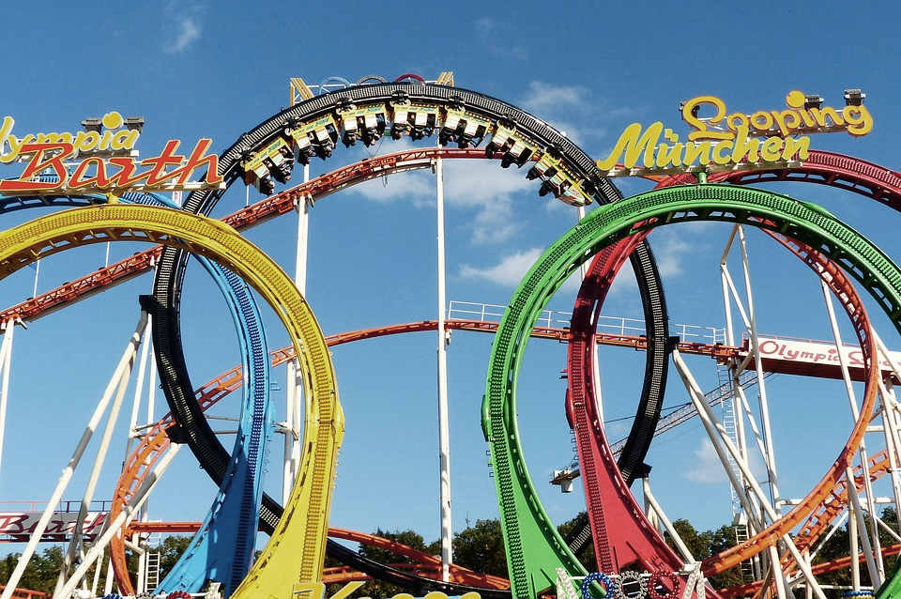

CSGE601020 | Dasar-Dasar Pemrograman 1
Loops/Perulangan
Fariz Darari
Notes:
https://pixabay.com/photos/looping-fivefold-olympia-looping-1689992/

Slide 2
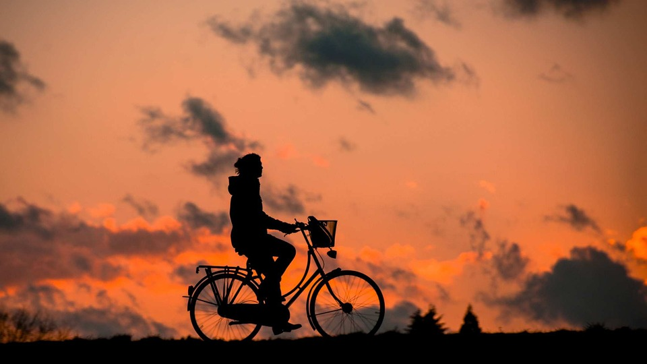
Conditionals and loops form the core of programming
Conditionals: Decision making based on some condition
Loops: Performing repetitive tasks
Notes:
And core of life too : - )
Riding a bicycle involves conditionals and loops

Slide 3
Simple password checker (without repeats)
Buatlah suatu program sederhana dengan conditionals, yang meminta password dari user. Jika passwordnya benar akan mencetak "OK :)" dan jika salah akan mencetak "That's not the right password :("

Slide 4

Simple password checker (without repeats)
pwd = input("Masukkan password: ")
real_pwd = "mar1ngod1ngpython!"
if pwd == real_pwd:
print("OK :)")
else:
print("That's not the right password :(")

Slide 5
Simple password checker (with repeats)
Buatlah suatu program sederhana dengan conditionals dan loops, yang meminta password dari user. Jika passwordnya benar akan mencetak "OK :)" dan jika salah akan mencetak "That's not the right password :("
Selama passwordnya salah, program akan terus meminta password dari user dan mengeceknya.
Notes:
Recall previous lecture

Slide 6
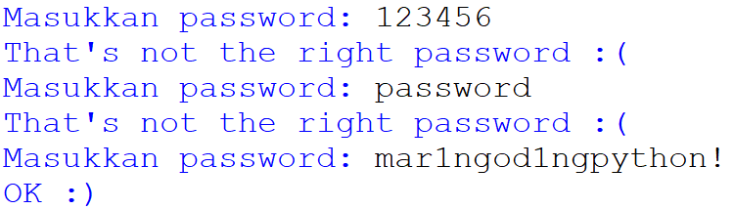
Simple password checker (with repeats)
pwd = input("Masukkan password: ")
real_pwd = "mar1ngod1ngpython!"
while pwd != real_pwd:
print("That's not the right password :(")
pwd = input("Masukkan password: ")
print("OK :)")

Slide 7
Simple password checker (with repeats) – Shorter code
real_pwd = "mar1ngod1ngpython!"
while input("Masukkan password: ") != real_pwd:
print("That's not the right password :(")
print("OK :)")
Notes:
Shorter, try it out if it's doing same thing as previous program

Slide 8
Be careful when making a while loop
while True:
print("This goes forever..")
Notes:
Shorter

Slide 9
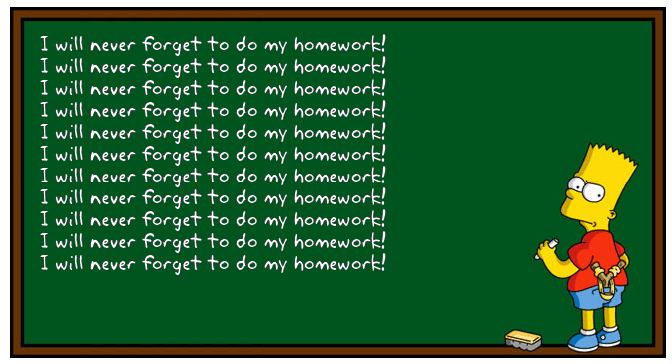
Suppose you have to do the same thing N times
Notes:
N can be 11 (as long as it's fixed/pasti)
http://www.addletters.com/pictures/bart-simpson-generator/6809755.htm

Slide 10
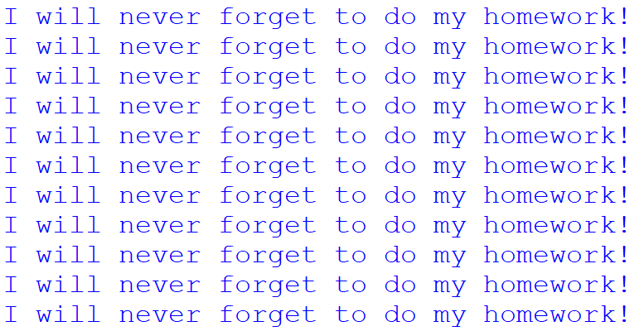
For loop: When knowing how many times the loop will execute
for i in range(11):
print("I will never forget to do my homework!")
Notes:
range can be changed to 100

Slide 11
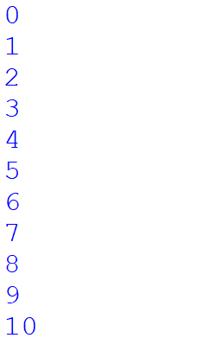
For loop: When knowing how many times the loop will execute
for i in range(11):
print(i)
Notes:
11 numbers, start from 0

Slide 12

For loop: When knowing how many times the loop will execute
for i in range(6,11):
print(i)
Notes:
11 numbers, start from 0

Slide 13

For loop: When knowing how many times the loop will execute
for i in range(6,11,2):
print(i)
Notes:
11 numbers, start from 0

Slide 14
Quiz time: What's the output?
for i in range(5):
if i % 2 == 0:
print("Genap")
else:
print("Ganjil")
Notes:
11 numbers, start from 0

Slide 15
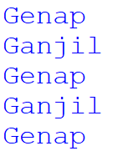
Quiz time: What's the output?
for i in range(5):
if i % 2 == 0:
print("Genap")
else:
print("Ganjil")
Notes:
11 numbers, start from 0

Slide 16


Thanks
and keep practicing!
Notes:
https://www.iconfinder.com/icons/4375050/logo_python_icon
https://www.iconfinder.com/icons/3099466/determined_face_icon

